Slide 1



Compute Fest 2018
Introduction to Deep Learning Image Classification using Keras
Pavlos Protopapas and David Wihl

Slide 2
Outline
Why Deep Neural Networks
Basic feed forward NN
Notebook with examples

Slide 3
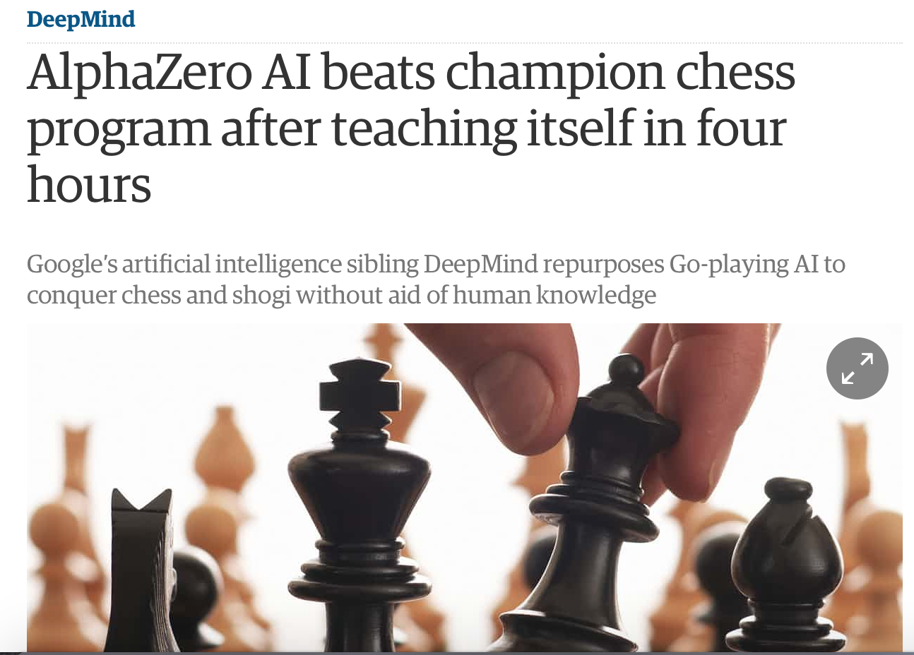
AlphaZero (2017)
theguardian.com

Slide 4
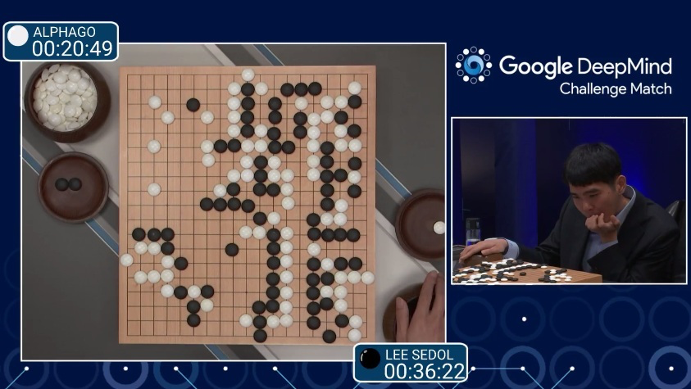
AlphaGo (2015)
First program to beat a professional Go player
Notes:
https://www.youtube.com/watch?v=PQCrX1sQSzY

Slide 5
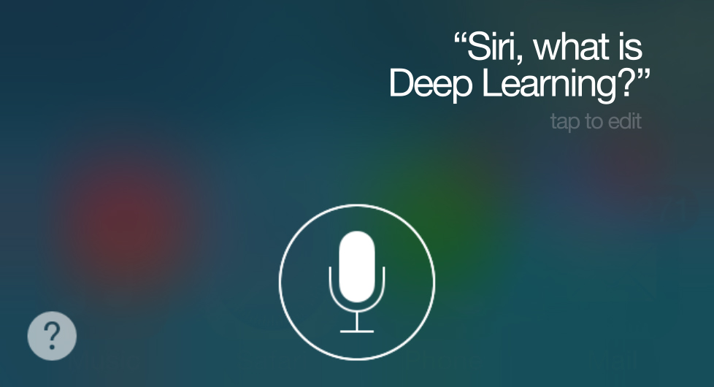
iOS Speech Synthesis (2016-)
Trained from 20 hours of high quality speech
machinelearning.apple.com
Notes:
https://machinelearning.apple.com/2017/08/06/siri-voices.html

Slide 6
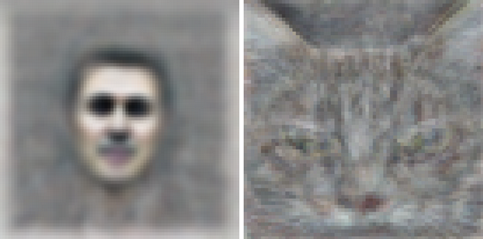
Google Brain (2012)
Differentiate between human face and cat
Neural network with 1 billion connections
10 million 200x200 pixel images from YouTube
Le et al., ICML 2012

Slide 7
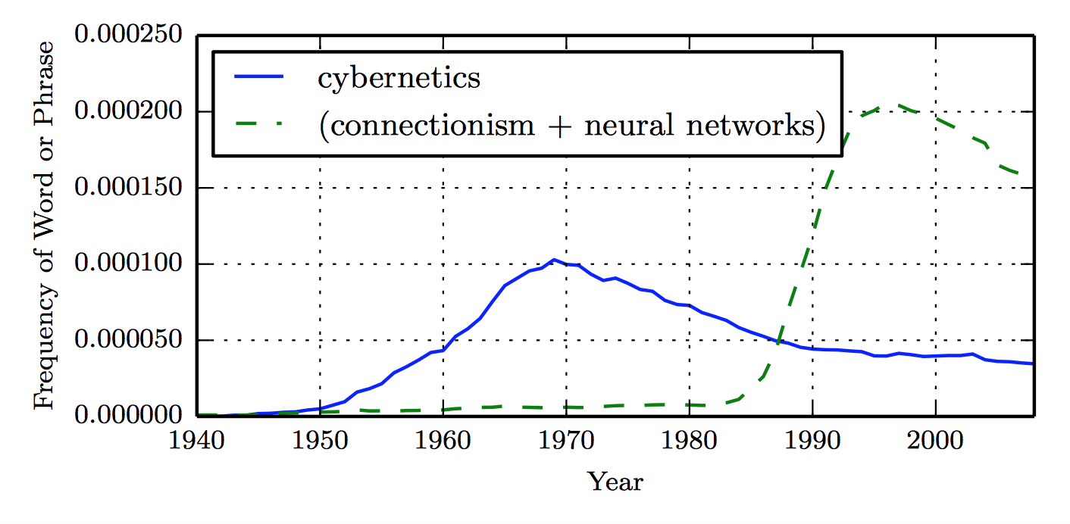
Historical Trends
LSTM
Distributed
Representation
Backprop
Perceptron
ADALINE
(Goodfellow 2016)

Slide 8
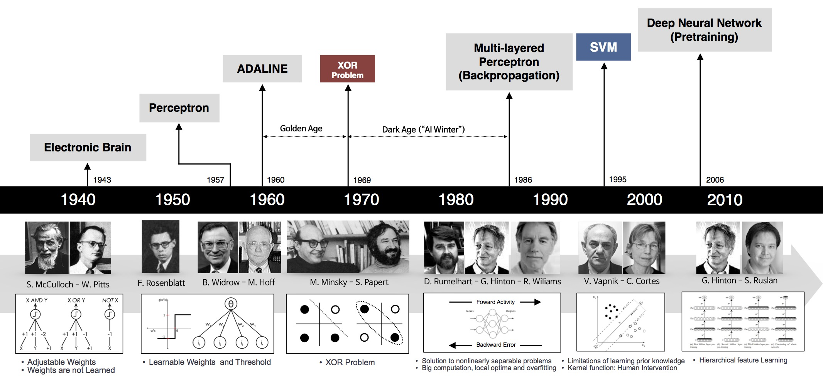
Historical Trends
beamandrew.github.io/
Notes:
https://beamandrew.github.io/deeplearning/2017/02/23/deep_learning_101_part1.html

Slide 9
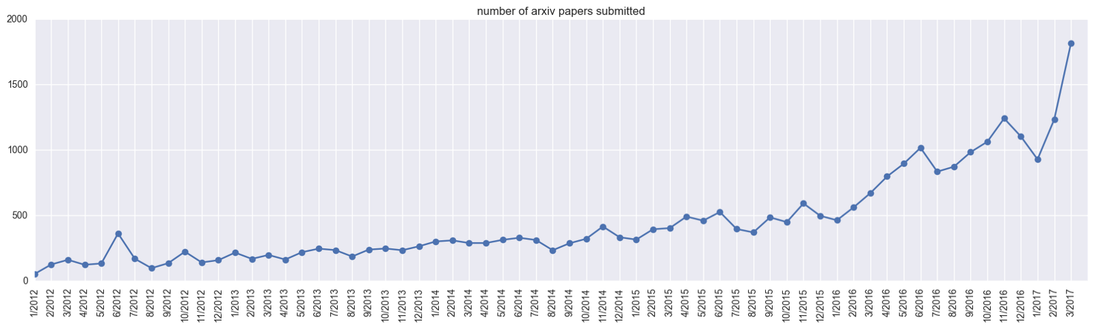
Historical Trends
ArXiv papers on deep learning: 2012-2017

Slide 10
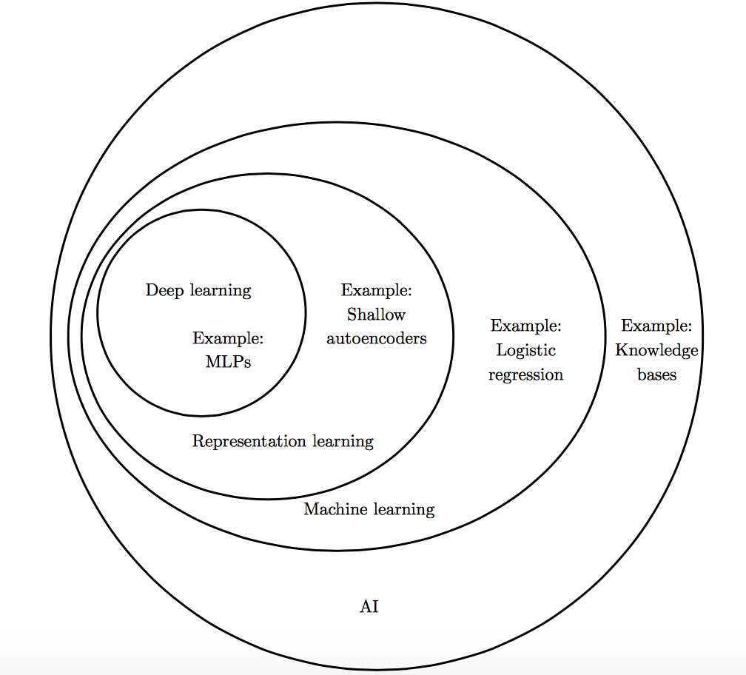
Deep Learning vs Classical ML
(Goodfellow 2016)

Slide 11
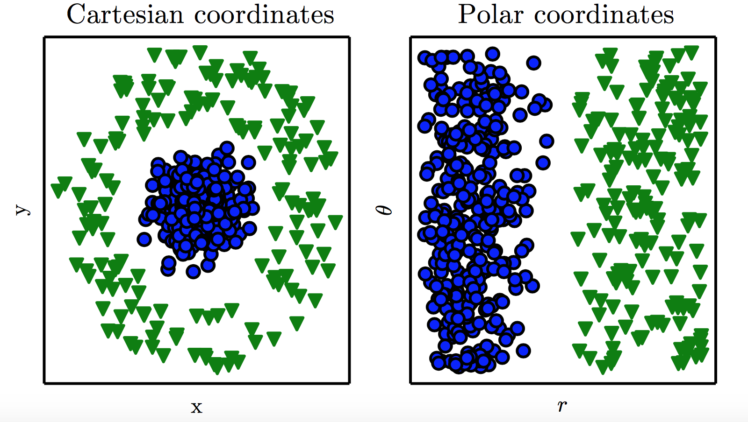
Representation Matters
(Goodfellow 2016)

Slide 12
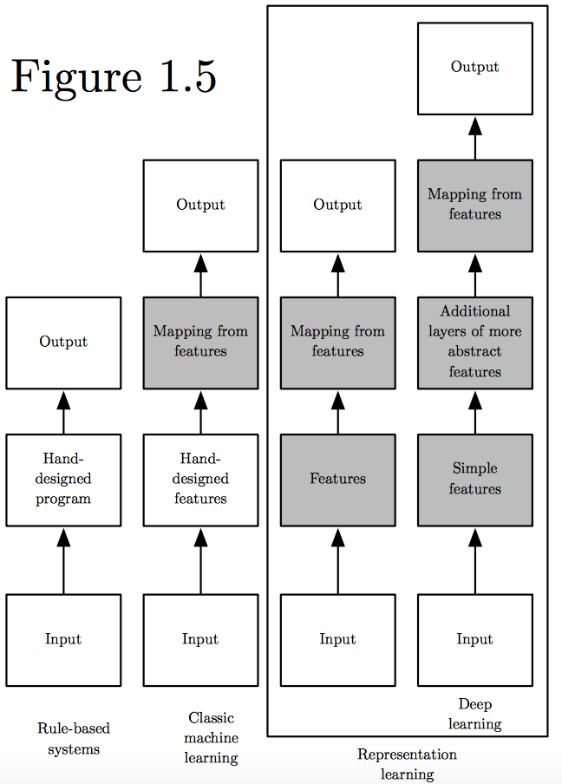
Learning Multiple Components
(Goodfellow 2016)

Slide 13
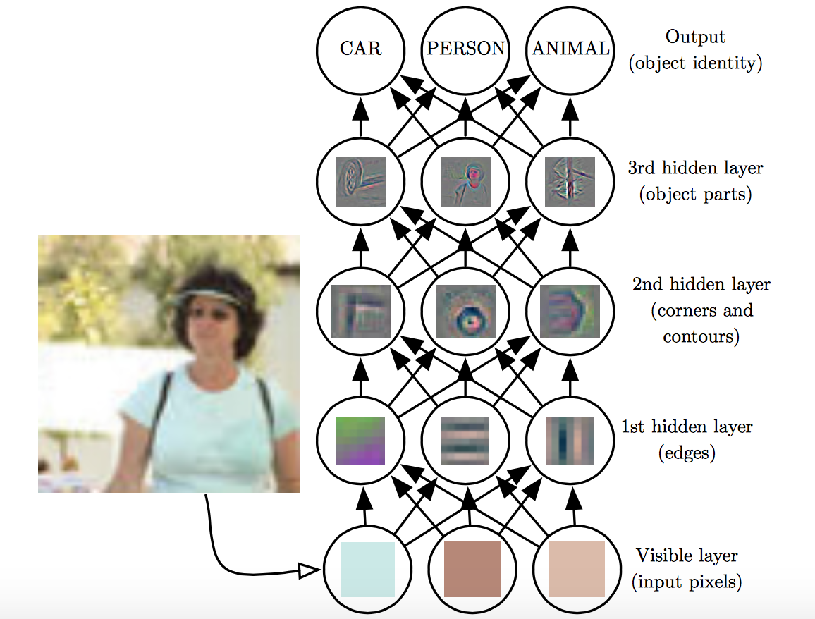
Depth = Repeated Compositions
(Goodfellow 2016)

Slide 14
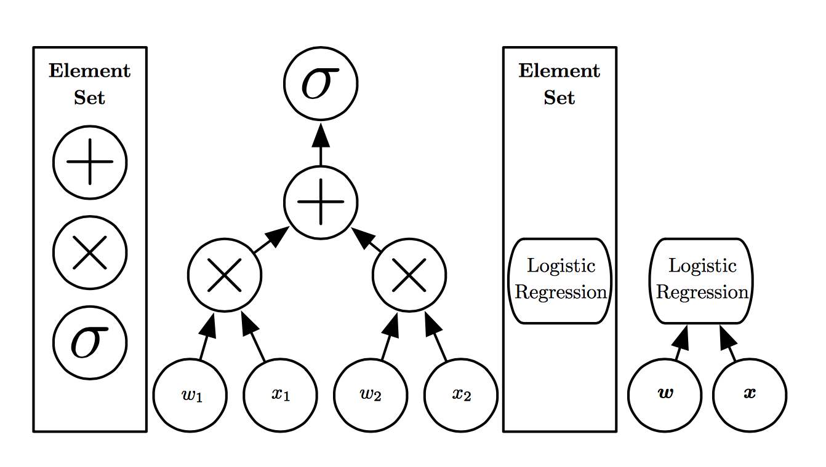
How to measure depth?
(Goodfellow 2016)

Slide 15
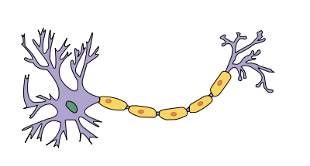
Is deep learning inspired by the brain?
en.wikipedia.org

Slide 16
Is deep learning inspired by the brain?
Earliest learning algorithms intended to model biological learning
Modern perspective:
Deep learning is a general principle of learning multiple levels of compositions, not necessarily neurally inspired

Slide 17
Why is deep learning so popular now?
Resurgence in 2006:
G. Hinton, O. Simon, and Y-W The. “A fast learning algorithm for deep belief nets”, Neural Computation, 2006
Breakthrough in 2012:
State-of-the-art performance in speech recognition
Best submission in Large Scale Visual Recognition Challenge (LSVRC)
beamandrew.github.io/

Slide 18
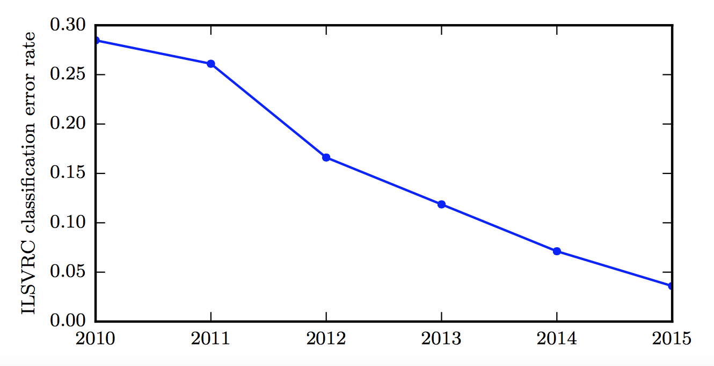
Increasing Accuracy
Large Scale Visual Recognition Challenge (LSVRC)
(Goodfellow 2016)

Slide 19
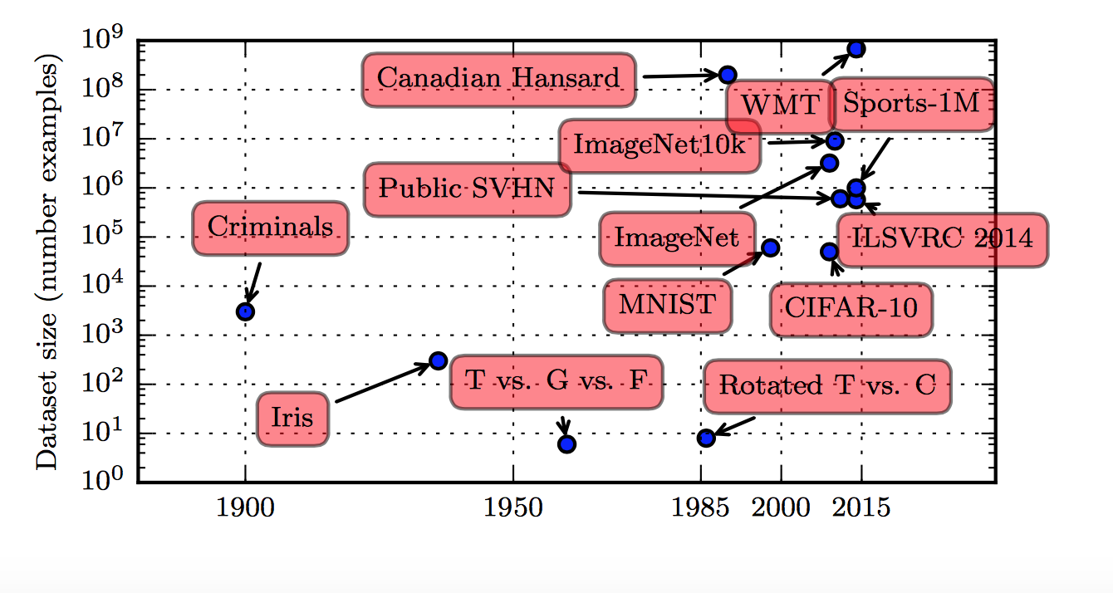
What changed?
Large, high-quality labeled data sets
(Goodfellow 2016)

Slide 20
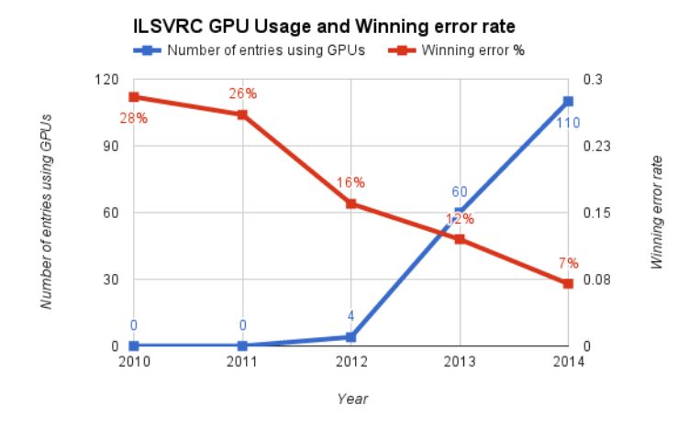
What changed?
Massively parallel computing with GPUs
beamandrew.github.io/

Slide 21
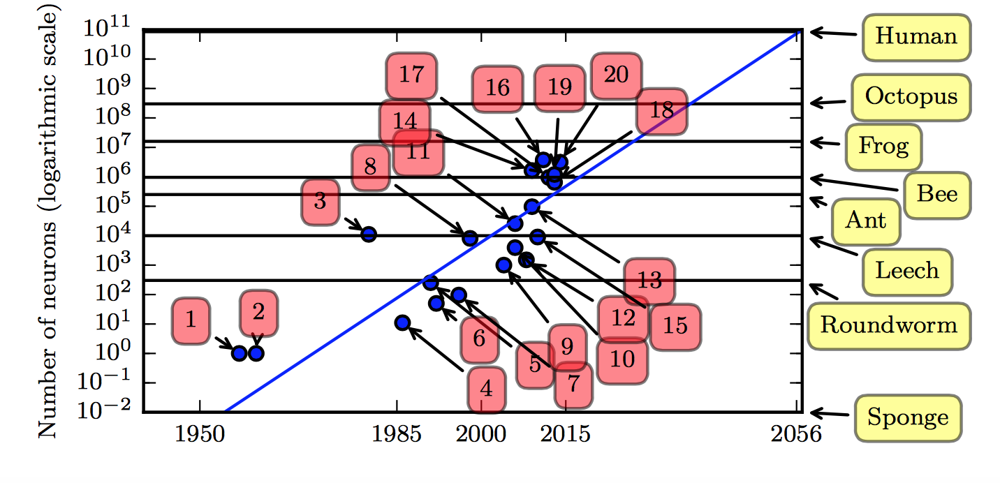
What changed?
Better architectures, improved model complexity
(Goodfellow 2016)

Slide 22
What changed?
New regularization techniques
Dropout
Batch normalization
Data augmentation
Notes:
https://towardsdatascience.com/activation-functions-neural-networks-1cbd9f8d91d6

Slide 23
What changed?
Robust optimizers: Improvements to stochastic gradient descent
Momentum
RMSProp
ADAM
…

Slide 24

What changed?
Backprop-friendly activation functions
Sigmoid -> Rectified Linear Units (ReLU)
Notes:
https://towardsdatascience.com/activation-functions-neural-networks-1cbd9f8d91d6

Slide 25
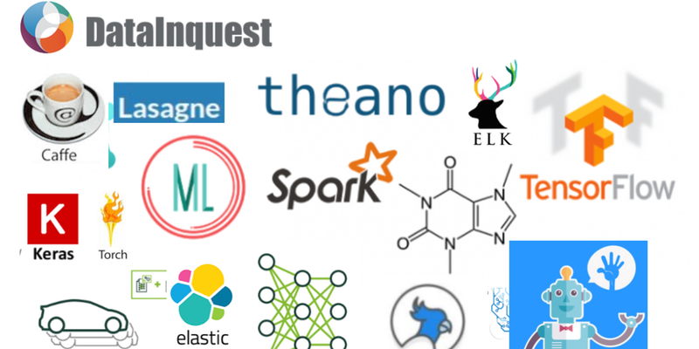
What changed?
Software platforms with auto-differentiation capabilities, seamless integration with GPUs
Notes:
https://towardsdatascience.com/activation-functions-neural-networks-1cbd9f8d91d6

Slide 26
Beyond Linear Models
Non-linear transform

Slide 27
Traditional ML
Manually engineer
Domain specific, enormous human effort
Generic transform
Maps to a higher-dimensional space
Kernel methods: e.g. RBF kernels
Over fitting: does not generalize well to unseen data
Cannot encode enough prior information

Slide 28
Deep Learning
Directly learn feature map?
Defined by
hidden layers of the neural network
Can encode prior beliefs, generalizes well
But, non-convex optimization

Slide 29
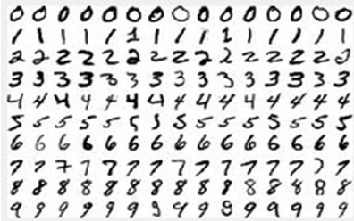
SVM vs. Neural Networks
Hand-written digit recognition: MNIST data
See illustration in notebook

Slide 30
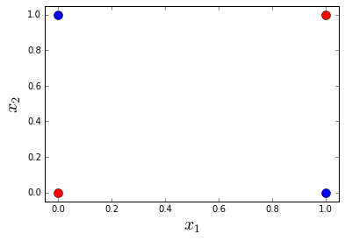
Example: Learning XOR
Optimal linear model (sq. loss)
Predicts 0.5 on all points

Slide 31
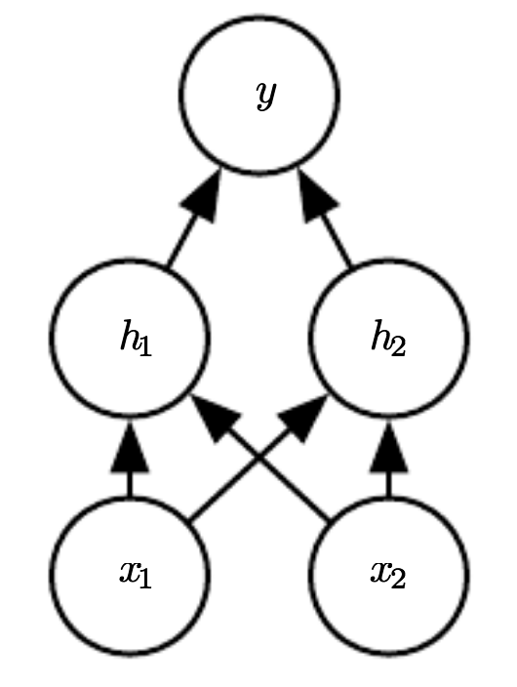
Example: Learning XOR
where,
See illustration in notebook

Slide 32
Design Choices
Cost function
Output units
Hidden units
Architecture
Optimizer

Slide 33
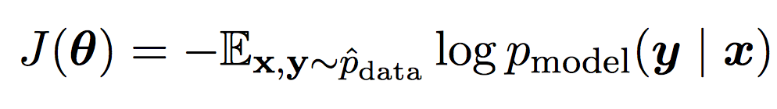
Cost Function
Cross-entropy between training data and model distribution (i.e. negative log-likelihood)
Do not need to design separate cost functions
Gradient of cost function must be large enough

Slide 34
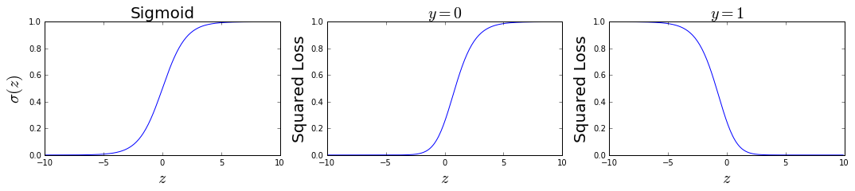
Cost Function
Example: sigmoid output + squared loss
Flat surfaces

Slide 35
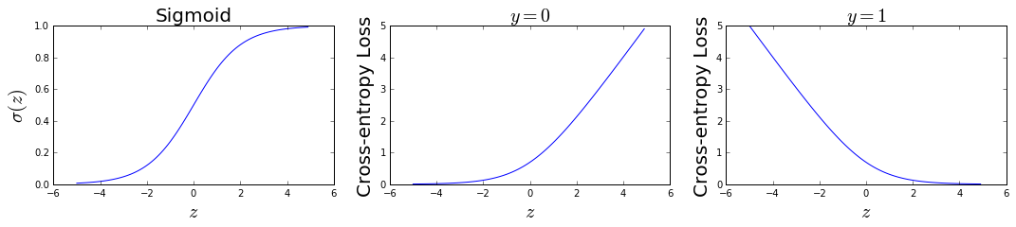
Cost Function
Example: sigmoid output + cross-entropy loss
log undoes exp
Saturates only when the model makes correct predictions

Slide 36
Design Choices
Cost function
Output units
Hidden units
Architecture
Optimizer

Slide 37
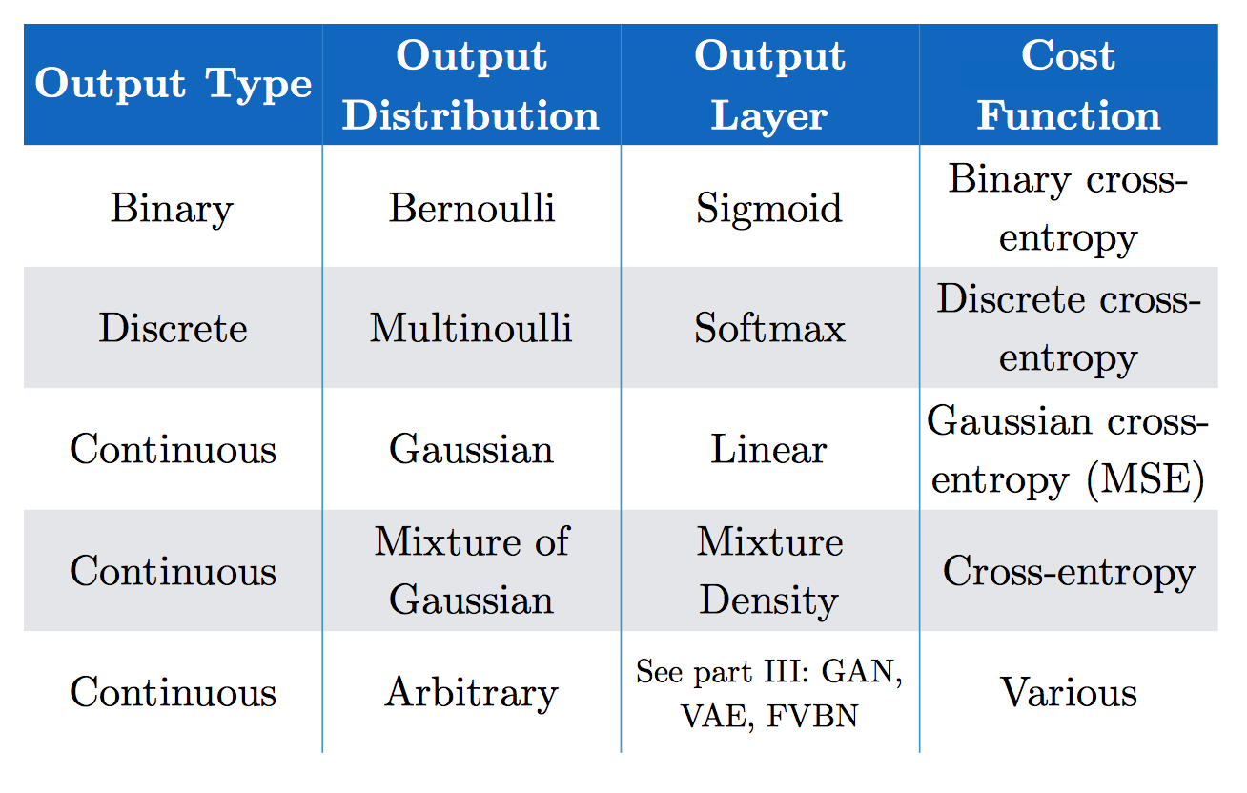
Output Units
(Goodfellow 2017)

Slide 38
Softmax Output
Discrete / Multinoulli output distribution
For output scores z₁, …, z_{n}
Log-likelihood undoes exp
(Score to target label – Maximum score)

Slide 39
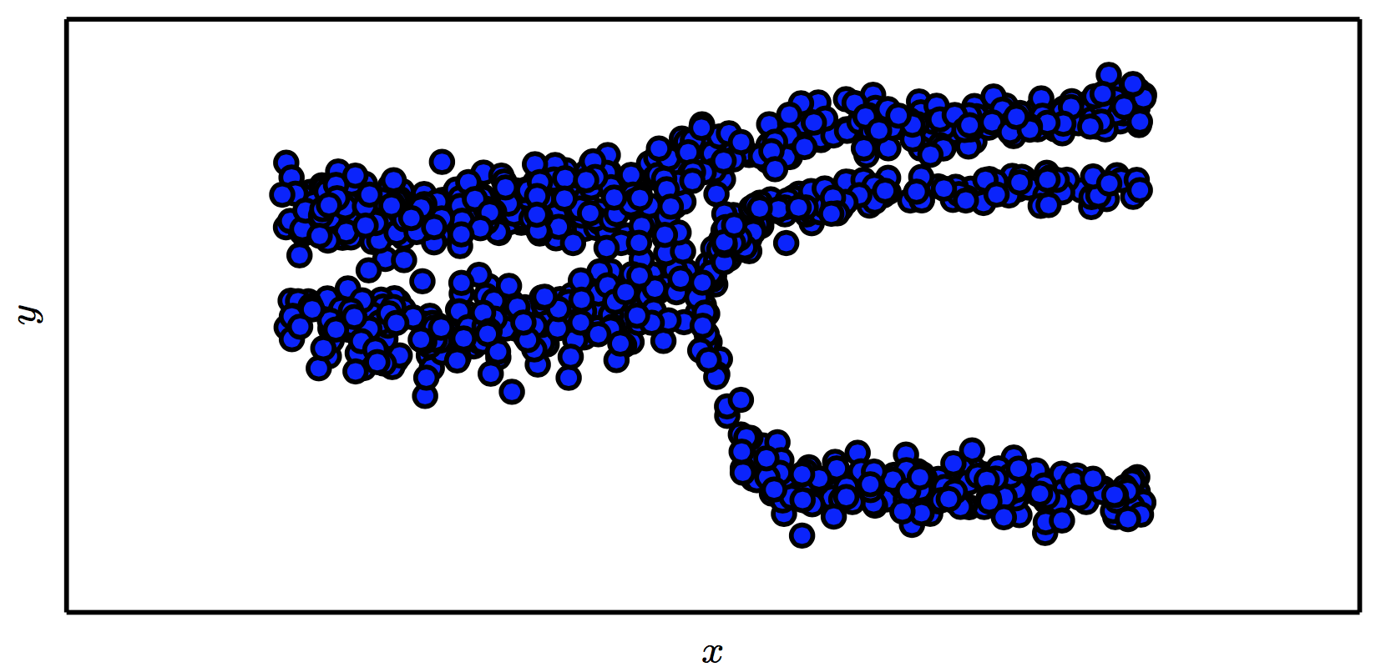
Mixture Density Output
(Goodfellow 2017)

Slide 40
Design Choices
Cost function
Output units
Hidden units
Architecture
Optimizer

Slide 41
Hidden Units
with activation function g
Ensure gradients remain large through hidden unit
Preferred: piece-wise linear activation
Avoid sigmoid/tanh activation
Do not provide useful gradient info when they saturate

Slide 42
ReLU
Rectified Linear Units
Gradient is 1 whenever unit is active
More useful for learning compared to sigmoid
No useful gradient information when z<0
0

Slide 43
Generalized ReLU
Generalization: For ,
E.g. Absolute value ReLU:
0

Slide 44
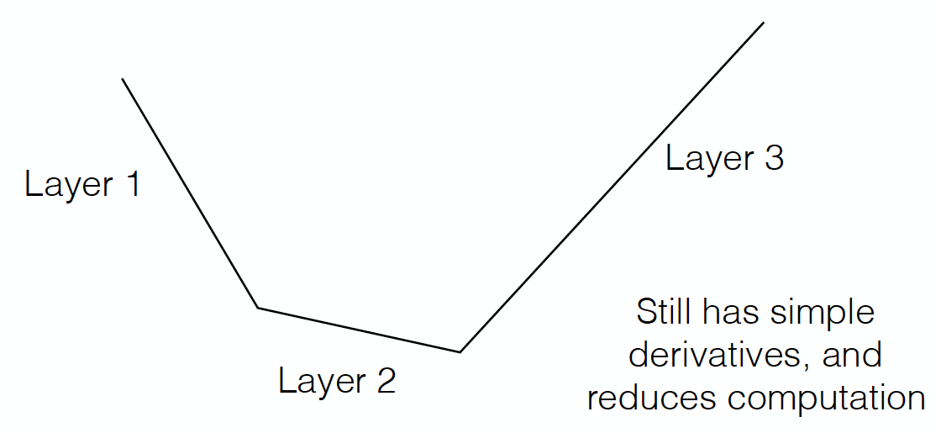
Maxout
Directly learn the activation function
Max of k linear functions
(α₁, β₁)
(α₃, β₃)
Line 3
(α₂, β₂)

Slide 45
Design Choices
Cost function
Output units
Hidden units
Architecture
Optimizer

Slide 46
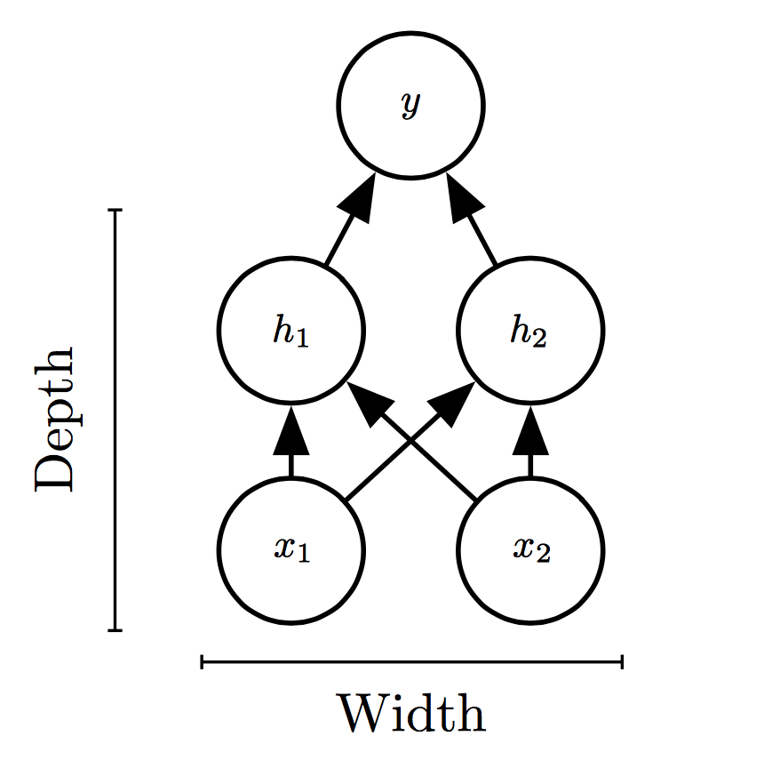
Universal Approximation Theorem
One hidden layer is enough to represent an approximation of any function to an arbitrary degree of accuracy
So why deeper?
Shallow net may need (exponentially) more width
Shallow net may overfit more

Slide 47
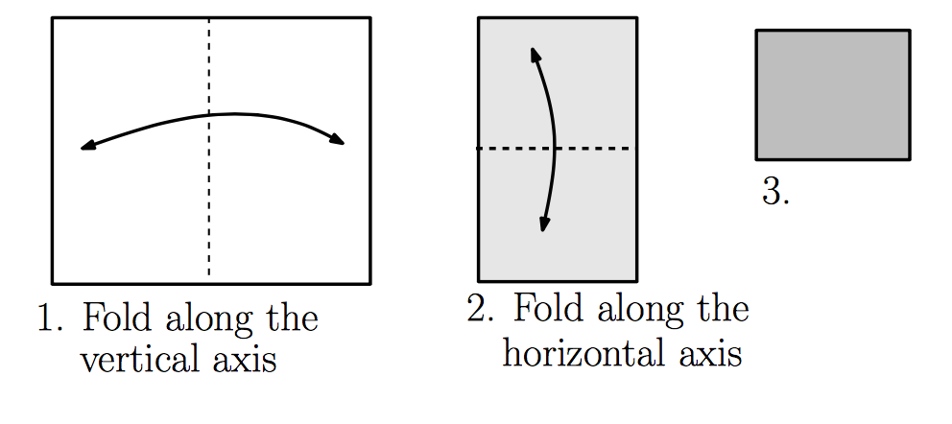
Exponential Gain with Depth
Each hidden layer folds the space of activations of the previous layer. E.g. abs activation
Montúfar (2014)

Slide 48
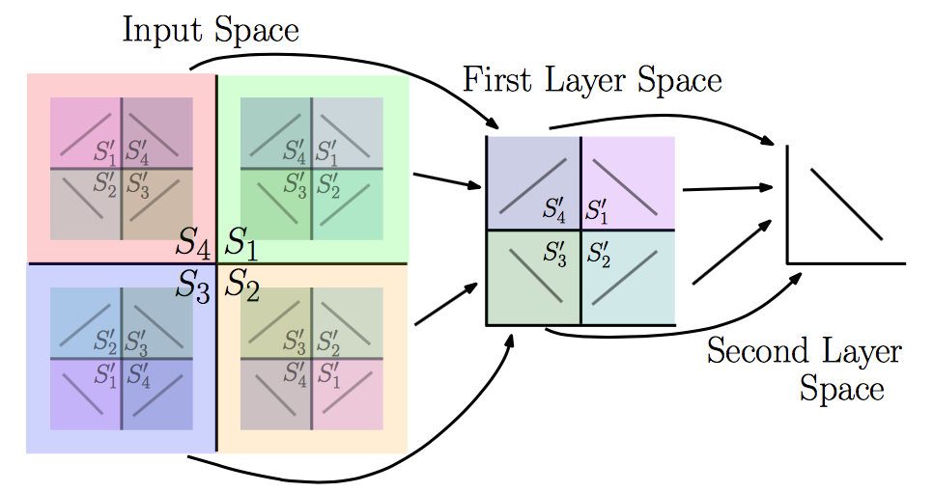
Exponential Gain with Depth
With N hidden layers, there are O(4^{N}) piecewise linear regions
Montúfar (2014)
See illustration in notebook

Slide 49
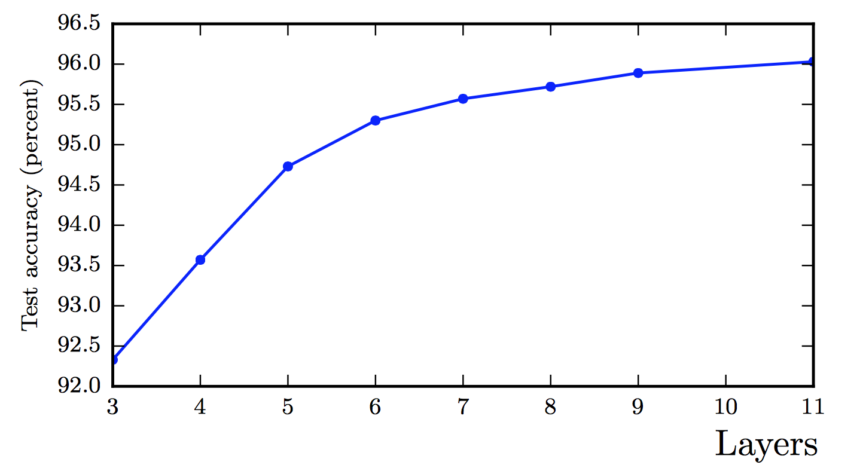
Better Generalization with Depth
(Goodfellow 2017)

Slide 50
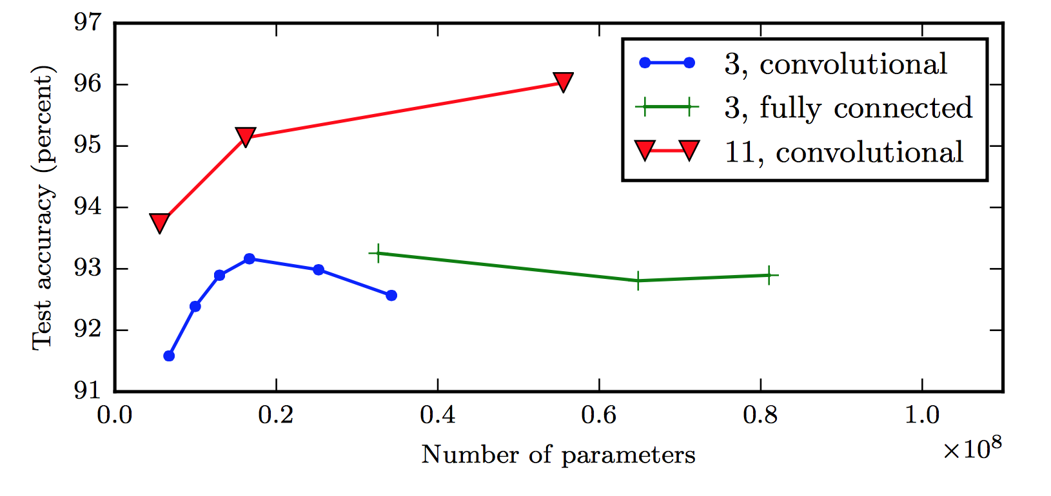
Large, Shallow Nets Overfit More
(Goodfellow 2017)

Slide 51
Design Choices
Cost function
Output units
Hidden units
Architecture
Optimizer

Slide 52
Gradient-based Optimizer (e.g. stochastic gradient descent)
“Chain rule” for computing gradients:
For deeper networks
Naïve computation takes exponential time

Slide 53
Backpropagation
Avoids repeated sub-expressions
Uses dynamic programming (table filling)
Trades-off memory for speed

Slide 54
Backprop: Arithmetic
Jacobian-gradient products
grad w.r.t. x
Jacobian of ‘g’
grad w.r.t. z
Apply recursively!

Slide 55
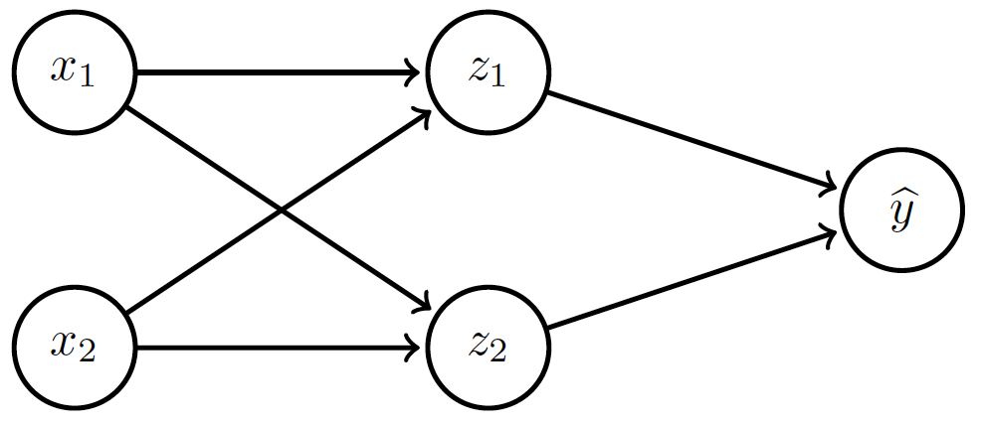
Backprop: Overview
Forward prop: compute activations
Compute loss
Back-prop: compute derivatives

Slide 56
Backprop: Example
Linear activation functions
No bias
Squared loss

Slide 57
Backprop: Example
Forward prop: Propagate activations to output layer

Slide 58
Backprop: Example
Backward prop: Compute loss and its derivative

Slide 59
Backprop: Example
Backward prop: Compute derivatives w.r.t. weights c₁ and c₂

Slide 60
Backprop: Example
Backward prop: Compute derivatives w.r.t. weights c₁ and c₂

Slide 61
Backprop: Example
Backward prop: Propagate derivative to hidden layer

Slide 62
Backprop: Example
Backward prop: Compute derivatives w.r.t. weights a₁, a₂, b₁ and b₂

Slide 63
Backprop: Example
Backward prop: Compute derivatives w.r.t. weights a₁, a₂, b₁ and b₂

Slide 64
Backprop: Example

Slide 65
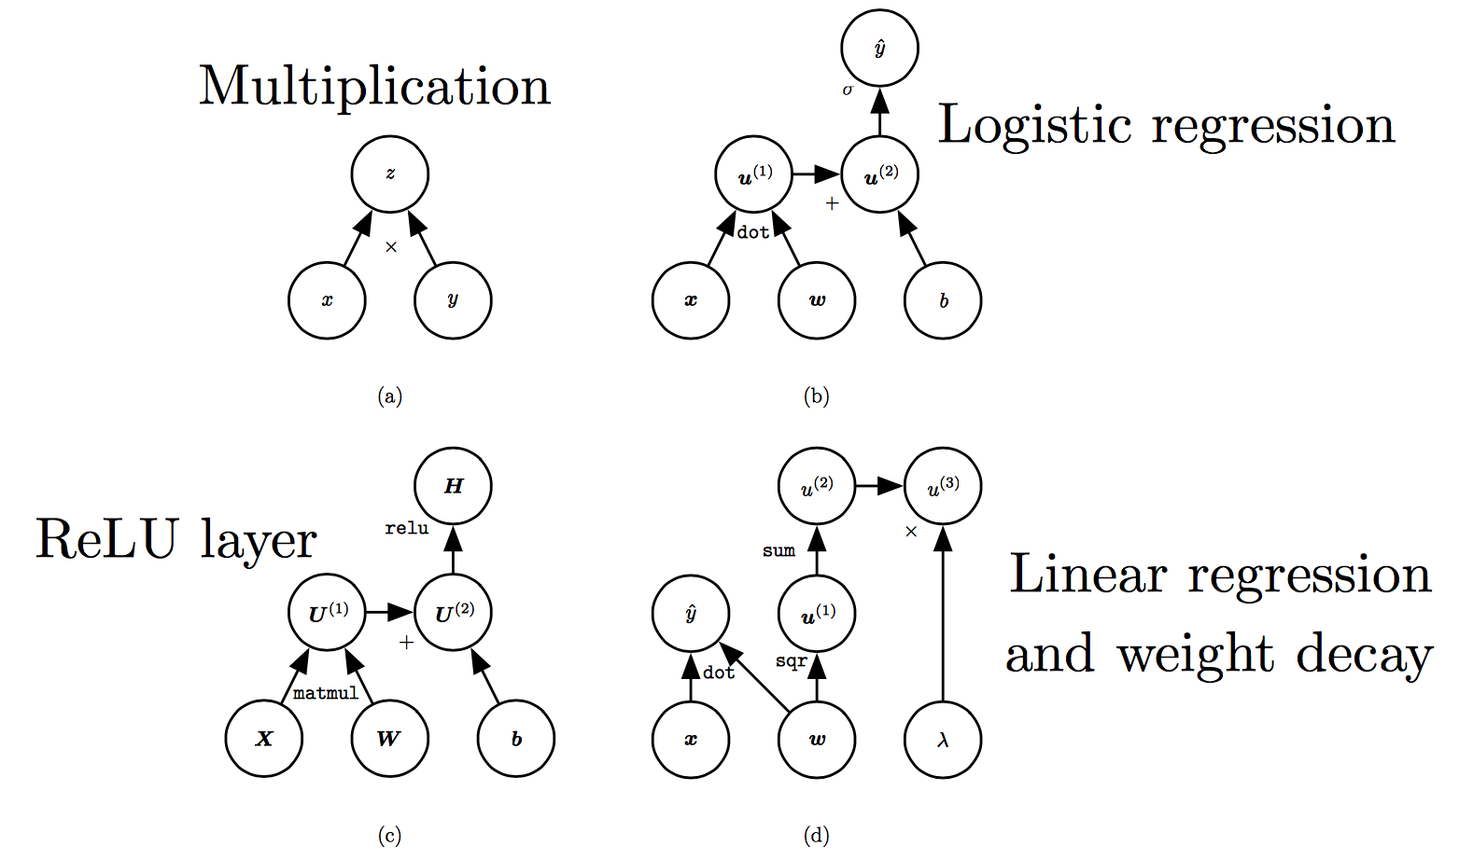
Computation Graphs
(Goodfellow 2017)

Slide 66
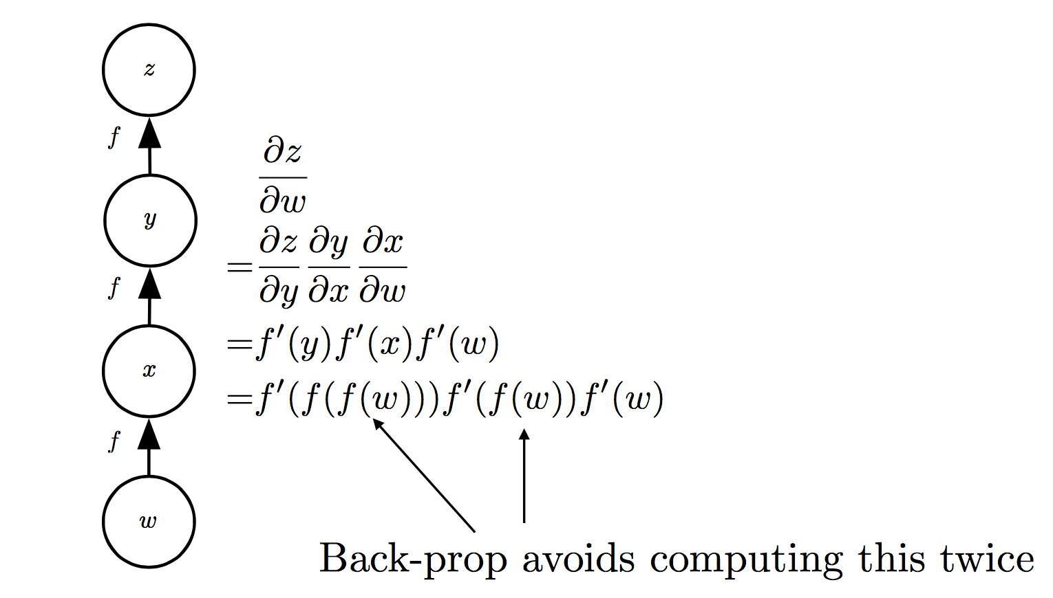
Repeated Sub-expressions
(Goodfellow 2017)

Slide 67
Backprop on Computation Graph
Maintain grad table
Parents of u^{i}

Slide 68
Symbol-to-symbol Differentiation
Derivatives as computation graphs
Same language for both forward and back-propagation
During execution, replace symbolic inputs with numeric value
Used by Theano and TensorFlow
Symbol-to-number differentiation: e.g. Torch and Caffe

Slide 69
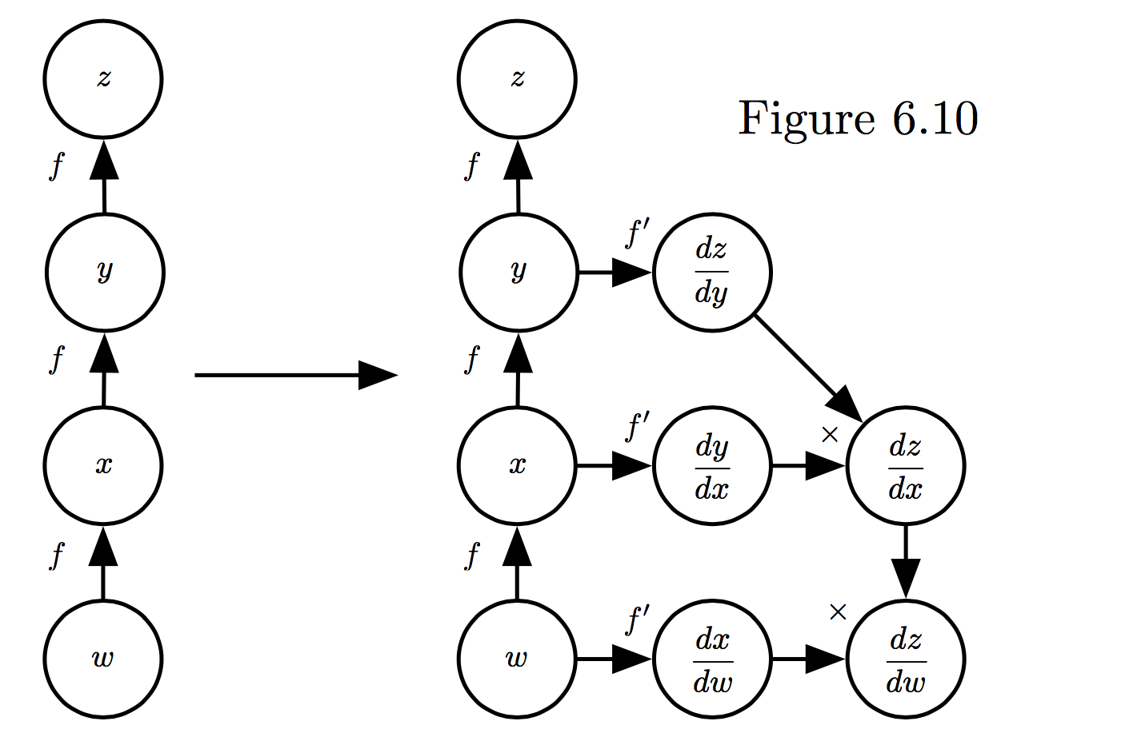
Symbol-to-symbol Differentiation
(Goodfellow et al. 2017)

Slide 70
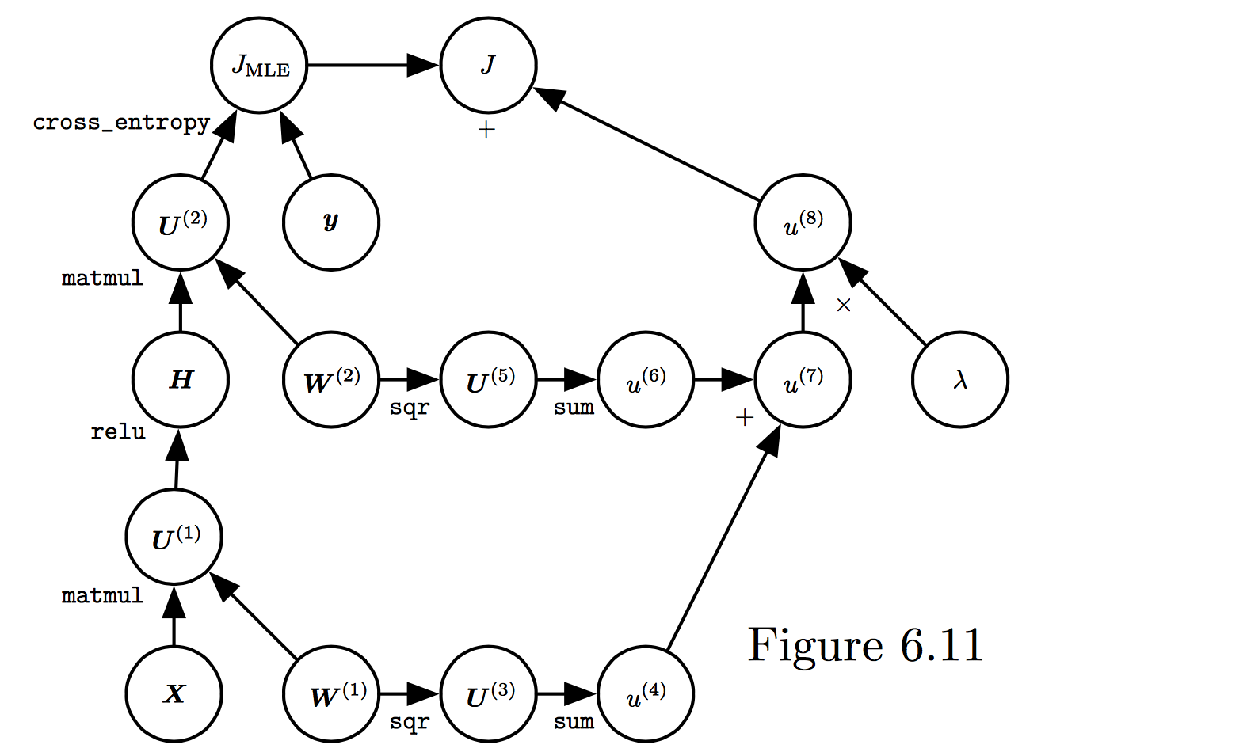
Training Feed-forward Nets
Computational cost for forward/back prop: O(#num-weights)
Memory cost:
O(#num-layers x minibatch-size)
(Goodfellow et al. 2017)

Slide 71
Notebook
https://github.com/cs109/2018-ComputeFest/

Slide 72
What is Theano?
An open source Python library for fast numerical computation (CPU or GPU). A key foundational library for deep learning models.
It was developed by the LISA (now MILA1) group at the University of Montreal, Quebec
sudo pip install Theano

Slide 73
# Example of Theano library import theano from theano import tensor # declare two symbolic floating-point scalars a = tensor.dscalar() b = tensor.dscalar()

Slide 74
TensorFlow

Slide 75
Keras
sudo pip install keras

